Slide 1
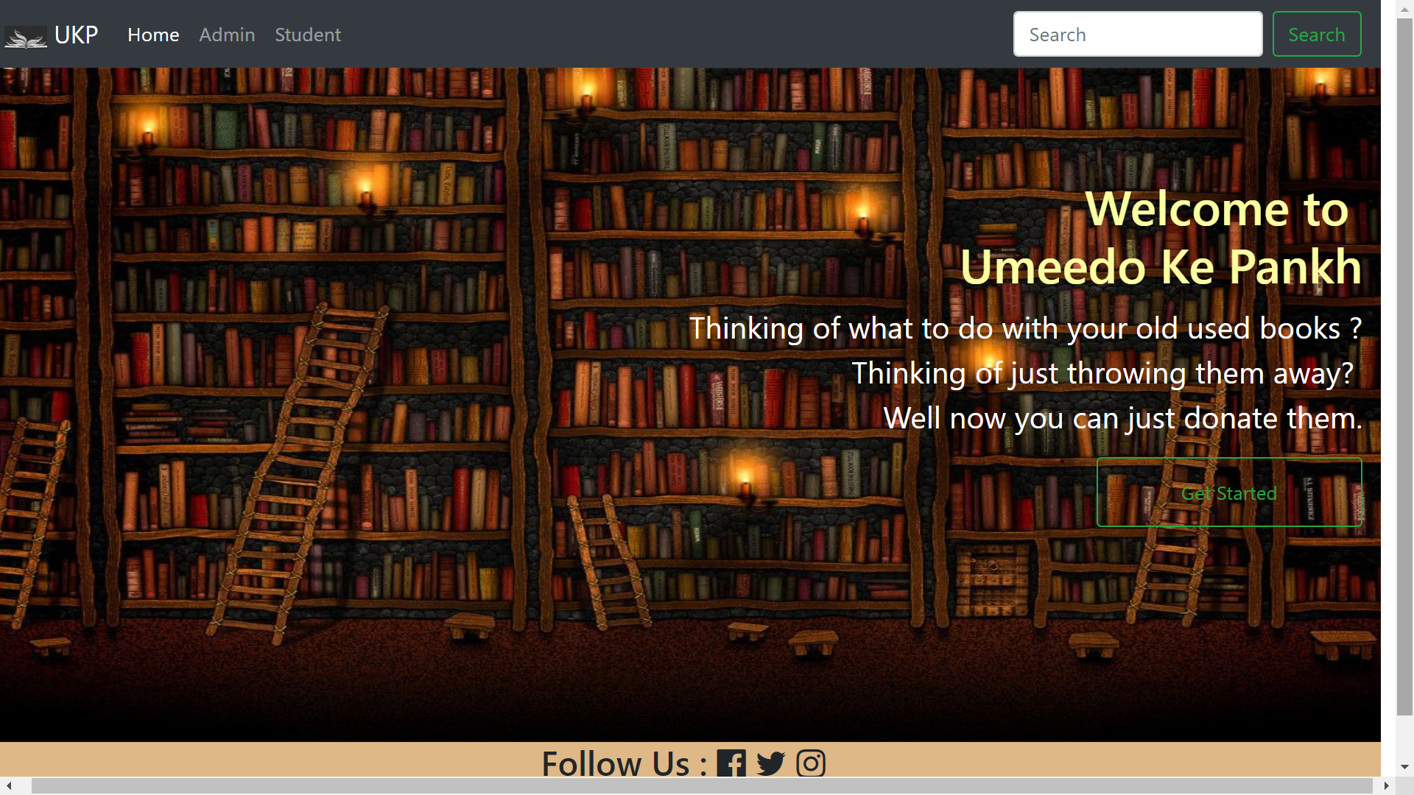
Problem Statement
Every year thousands of graduates, throw their books which are of no use to them anymore while on the other hand there are those who can't afford one. So using "UMEEDO KE PANKH" as a platform they can donate books to the needy.

Slide 2
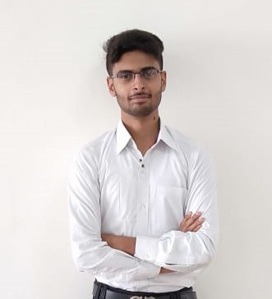
Candidate
Name – Satyam Tewari
Reg. No. – 1613101636
Phone No. – 9971139334
Email id – satyamtewari13@gmail.com
Github Id - https://github.com/SatyamTewari

Slide 3
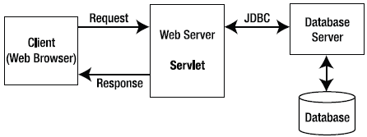

Backend Development
Register.java
Login.java
BookInsert.java
GetPhoto.java
index.jsp
student_login.jsp
studentwindow.jsp
student-login-failure.jsp
register _response.jsp

Slide 4
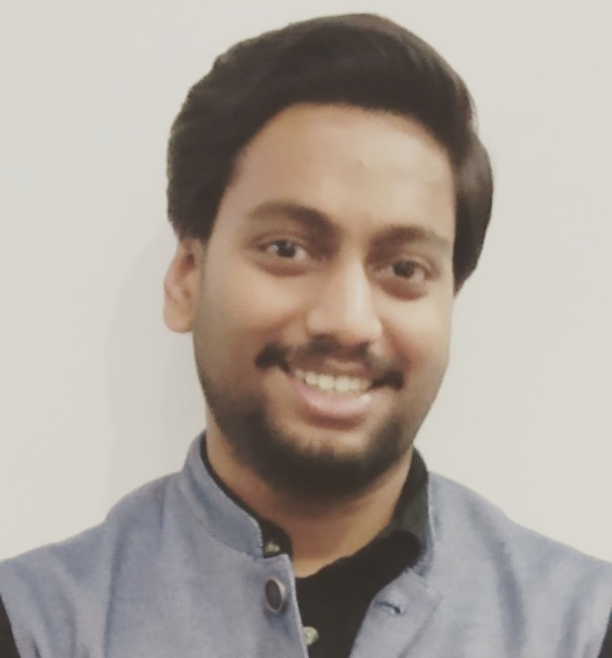
Candidate
Name – Ashutosh Srivastava
Reg. No. – 1613114015
Phone No. – 9958732904
Email id – ashutosh65000@outlook.com
Github Id - https://github.com/ashutosh-65000

Slide 5

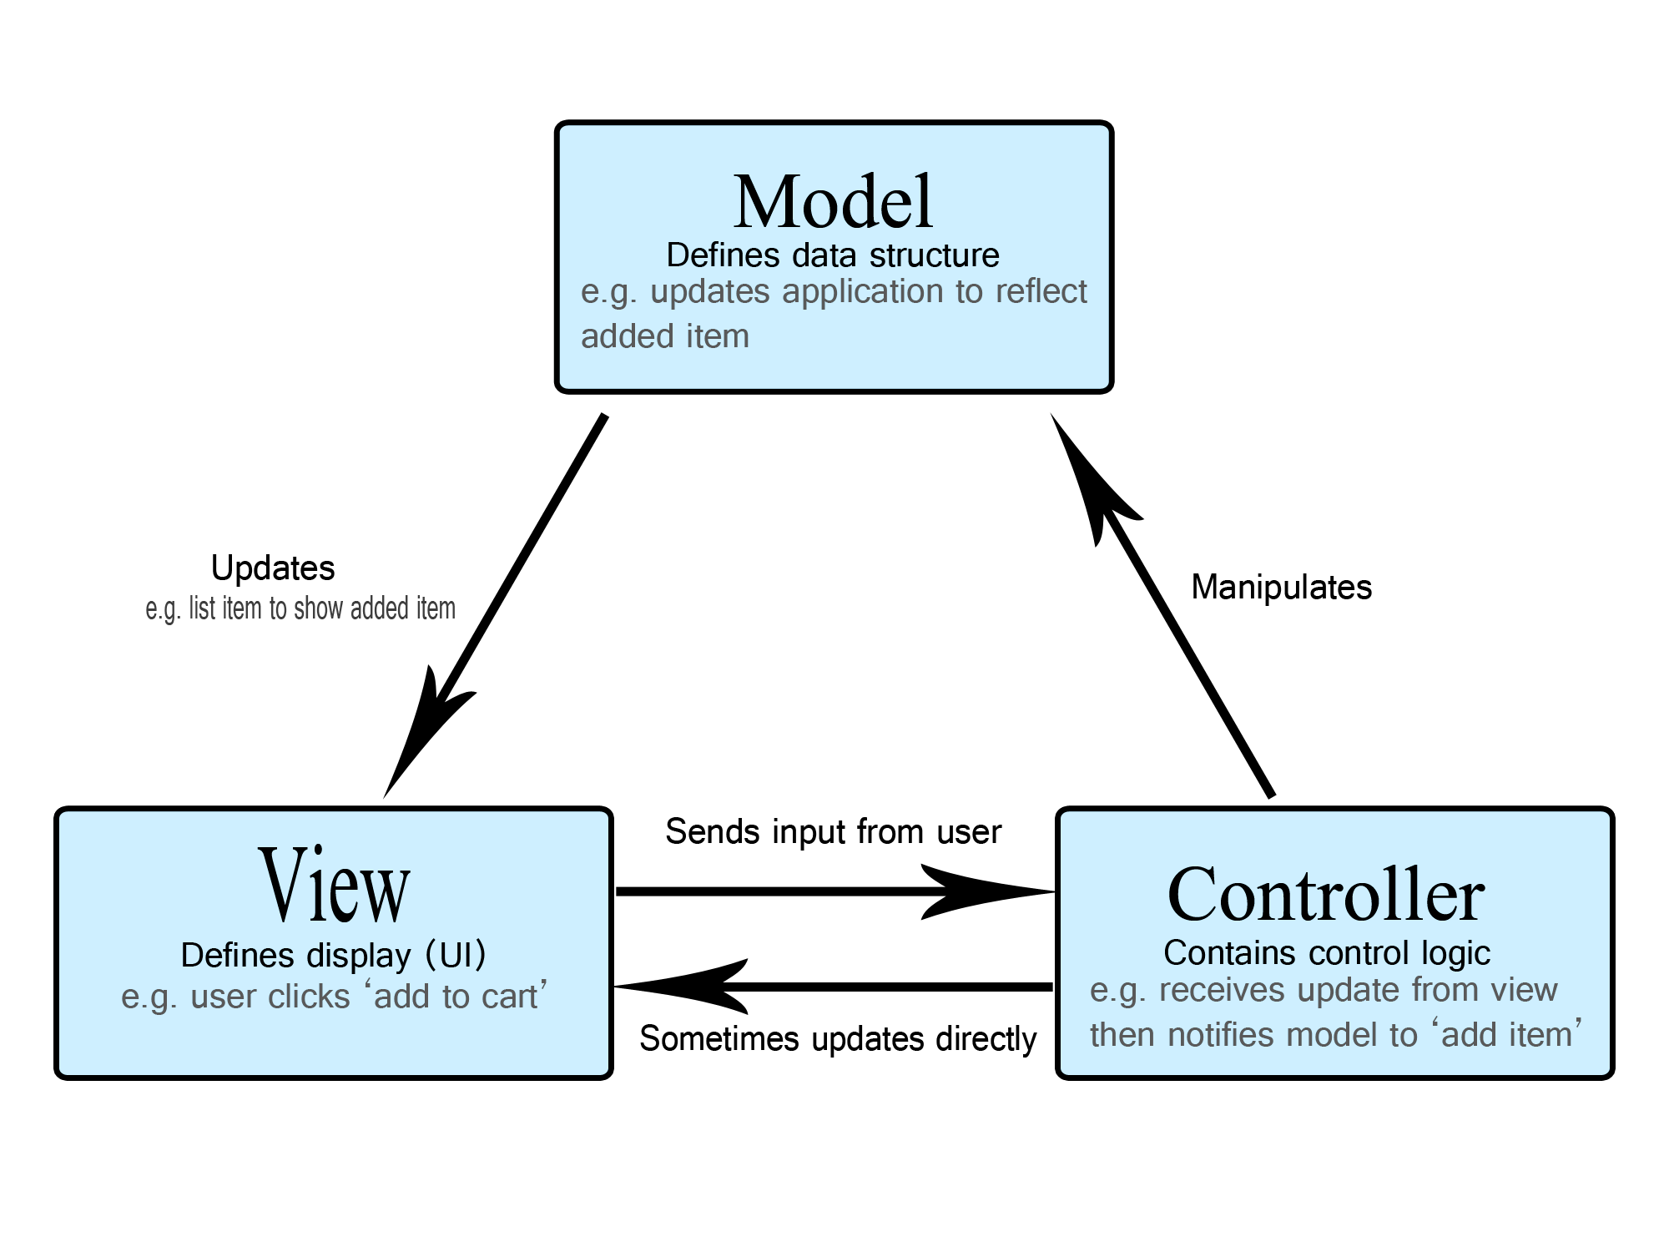
Backend Development
MVC Model approach
Reset.java
DbConnect.java
Distribute.java
admin_login.jsp
frgtpswd.jsp
adminwindow.jsp
logout.jsp

Slide 6
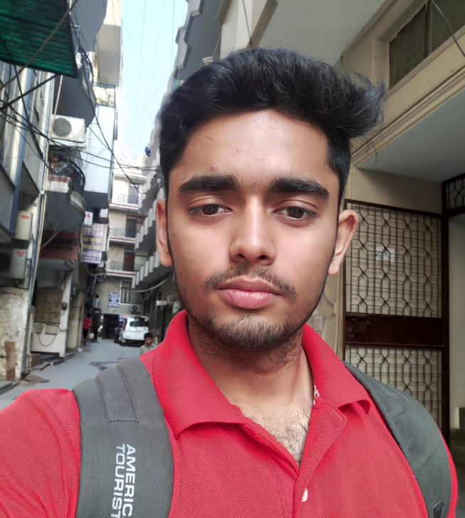
Candidate
Name – Piyush Tiwari
Reg. No. – 1609710081
Phone No. – 7011618175
Email id – kashyappiyush1998@gmail.com
Github Id - https://github.com/kashyappiyush1998

Slide 7


DATABASE
WHAT IS ORACLE DATABASE
ADVANTAGES OF ORACLE DATABASE
NORMALIZE TABLES
ESTABLISH CONNECTION
SQL
CREATE, ALTER AND DROP TABLES
CREATING TABLES IN A DATABASE
SELECT ROWS FROM A TABLE
PERFORM OPERATION ON AN ENTRY
CREATE PRIMARY KEYS AND TRIGGERS
CREATE FOREIGN KEYS

Slide 8
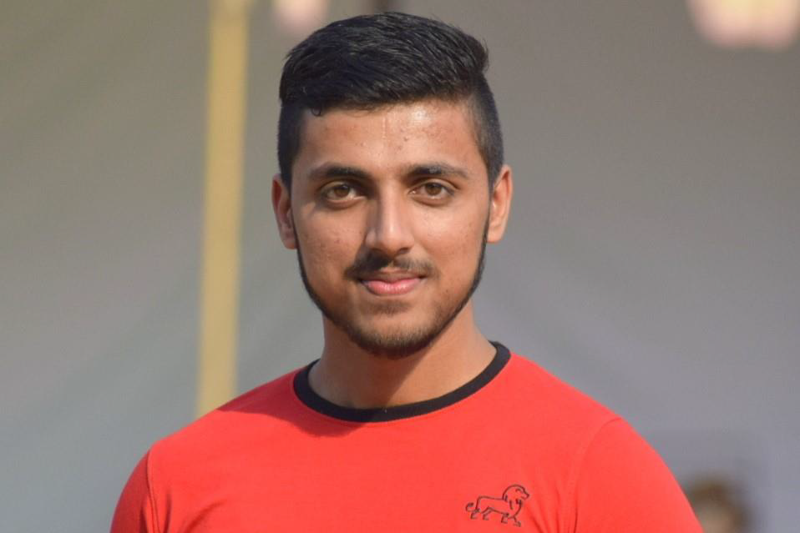
Candidate
Name - Pranjal Singh
Reg. No. -1609713065
Phone No. - 8130425826
Email Id - pranjalsingh.singh24@gmail.com
Github ID - https://github.com/pranjalsk98

Slide 9
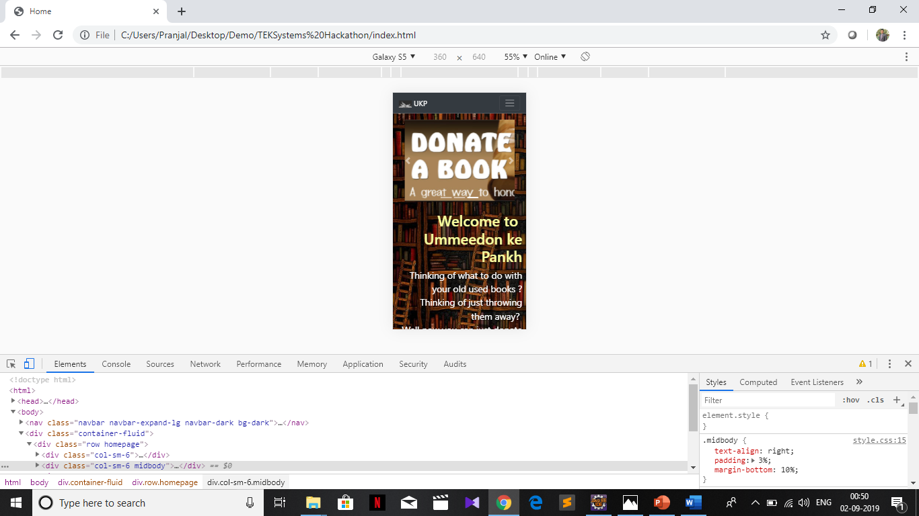

Frontend Development
Index.html
Admin-login.html
Student-registeration.html
Student-login.html
Student-window.html
Admin-window.html
Style.css
Technologies Used
HTML
CSS
Bootstrap
JavaScript(For client side validation only)

